Slide 1
Test-Data Generation using genetic algorithm

Slide 2

1.Introduction
1. Expensive
2. Labor intensive
Automated Test-data
Generation is important

Slide 3
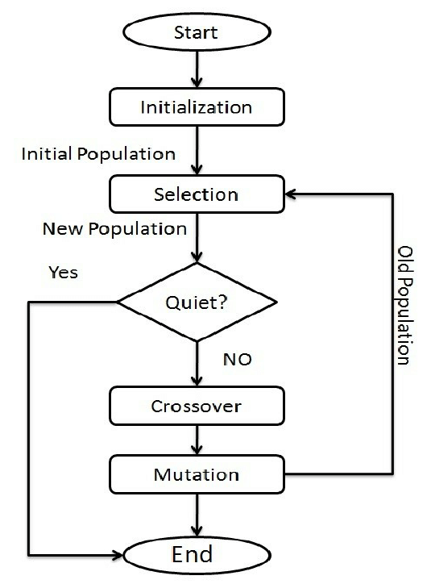
2.BackGround(Genetic Algorithms & CDG)
A famous Algorithm based on Darwinism and Natural selection

Slide 4
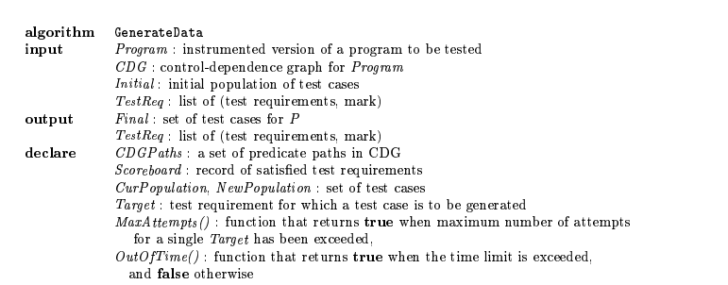
3. Test-Data Generation using genetic algorithm

Slide 5
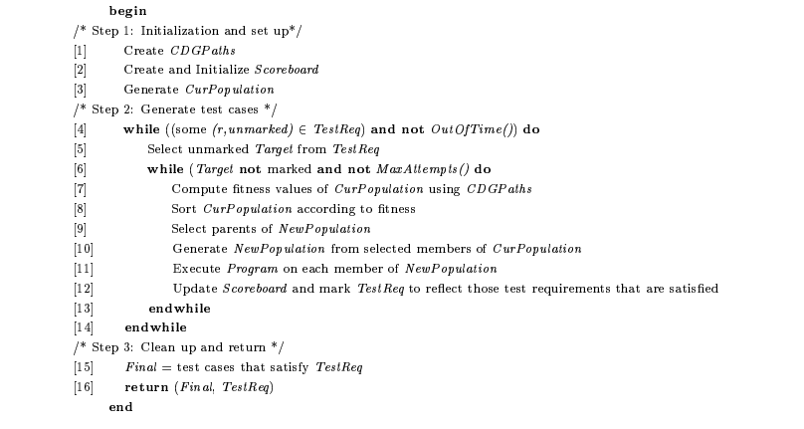

Slide 6

Step1
`Create CDGPaths`: This line creates a new CDGPaths object. CDGPaths stands for Control Dependence Graph Paths. These are used in software engineering to analyze the control flow of a program.
‘Create and initialize Scoreboard’: create records of satisfied test requirements
‘Generate CurPopulation’ : creates a new population (set of test cases)

Slide 7
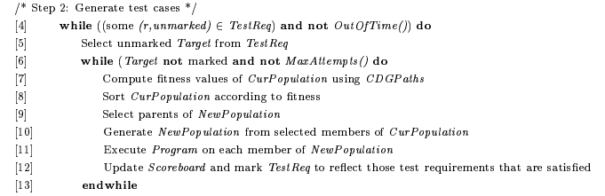
Step2
1.`while (some target nodes are not satisfied) do`: This line starts a while loop that will continue until some target nodes are satisfied
2.`Select target nodes from TestReq`: This line selects the target nodes from the TestReq object. TestReq is a data structure that contains the targets that the algorithm is trying to find.
4. `Compute fitness of CurPopulation using CDGPaths`: This line computes the fitness of the current population of potential solutions using the CDGPaths object and the fitness function.
5. `Sort CurPopulation according to fitness`: This line sorts the current population of potential solutions according to their fitness.
6. `Generate NewPopulation for each member of CurPopulation`: This line generates a new population of potential solutions by applying genetic operators such as mutation and crossover to each member of the current population.
7. `Update Scoreboard and mark TestReq to reflect those requirements that are satisfied`: This line updates the scoreboard and marks the TestReq object to reflect the requirements that have been satisfied.

Slide 8

Step3
14. `Return Final TestReq and TestKey`: This line returns the final TestReq and TestKey objects.

Slide 9
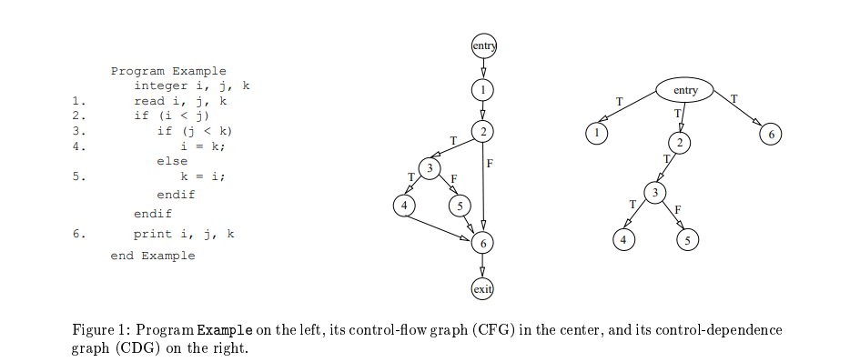

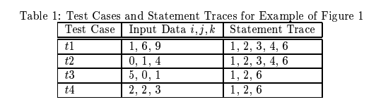
example

